Slide 1
Capstone Project
Airbnb Bookings Analysis by Rajesh Kumar Mishra Data Science Trainee AlmaBetter, Bengaluru

Slide 2


Since 2007, Airbnb operates an online marketplace for lodging, homestays & tourism activities.
Introduction

Slide 3
id unique id
latitude coordinate
name representing an accommodation
Dataset Information
(48895, 16)
longitude coordinate
host_id unique id for host
neighbourhood_group a group of area, 5 unique hoods
neighbourhood falls under group
price price of property
calculated_host_listing_count no of registered listing under a host
Null count:
name - 16
host_name – 21
last_review – 10052
reviews_per_month - 10052
room_type 3 unique room types
availability_365 number of days a host is available
minimum_nights minimum nights stay required
number_of_reviews total rating count of a listing
reviews_per_month rate of review given per month
last_review date of last review given

Slide 4
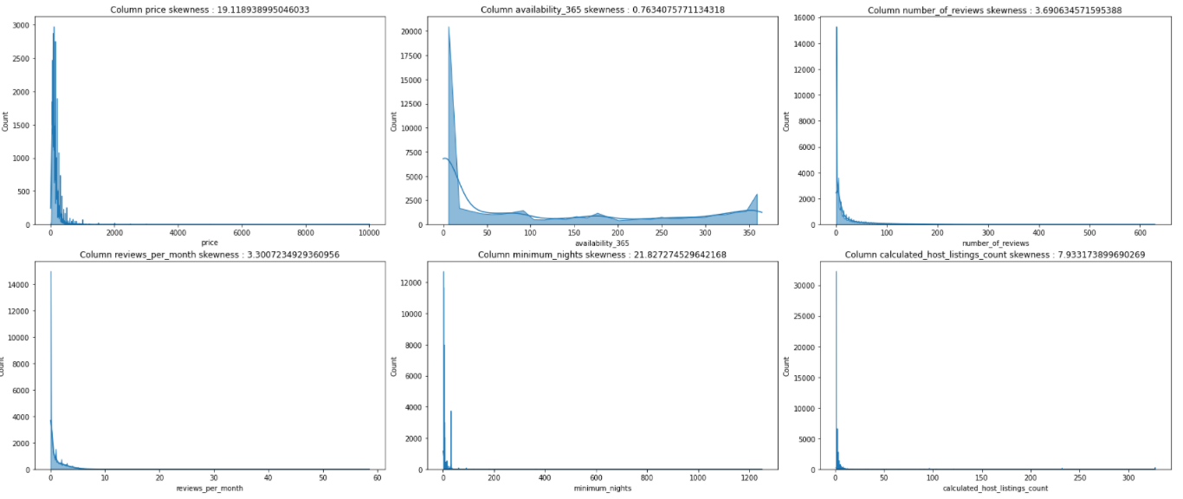
Positive skewed distribution
Distribution of Features
availability_365 has almost uniform distribution

Slide 5
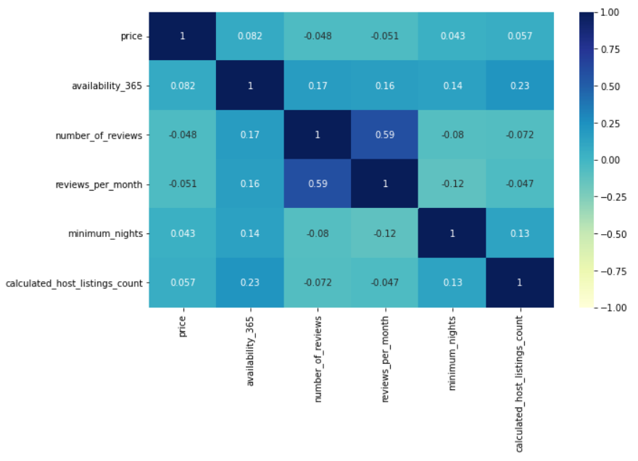
Correlation
Matrix
Lowest between:
minimum_night - price
Highest between:
reviews_per_month – number_of_reviews
All the features are less correlated with price, regression taking price as target, will be less accurate

Slide 6
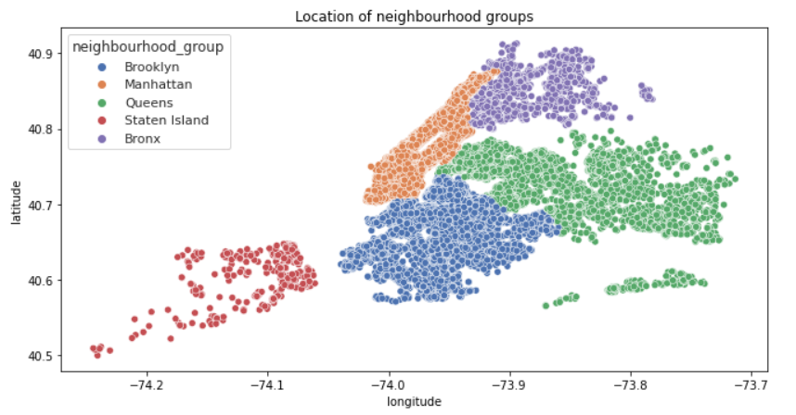
Location of Neighbourhood Groups
5 unique groups :
--------------------------
Manhattan
Brooklyn
Queens
Staten Island
Bronx
There are 211 unique neighbourhoods falls under 5 groups

Slide 7
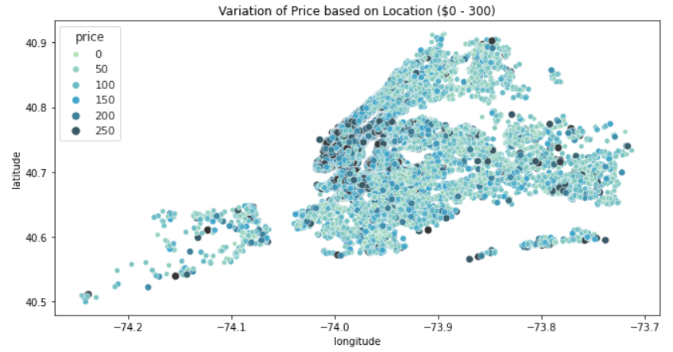
Variation of
Price based
on Location
Considered price range is $0 - 300
75% of properties has price within $175
Avg. price of Manhattan & Brooklyn is $161.98
Property prices are generally high in the southern area of Manhattan and northern area of Brooklyn
Avg. price of rest of the NY is $98.47

Slide 8
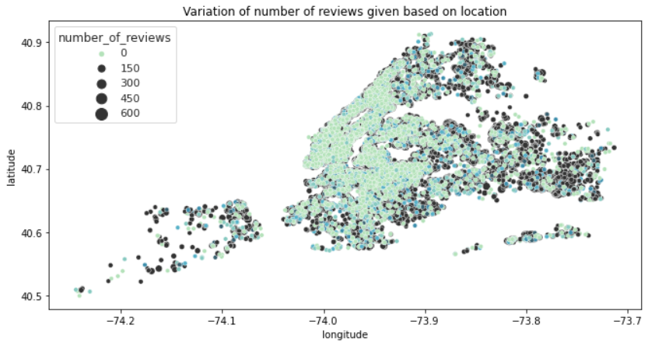
Variation of
Number of reviews given based on Location
Staten Island holds max 30.94 avg. reviews per property
Trend in rise of review counts is followed in the outskirts of NYC

Slide 9
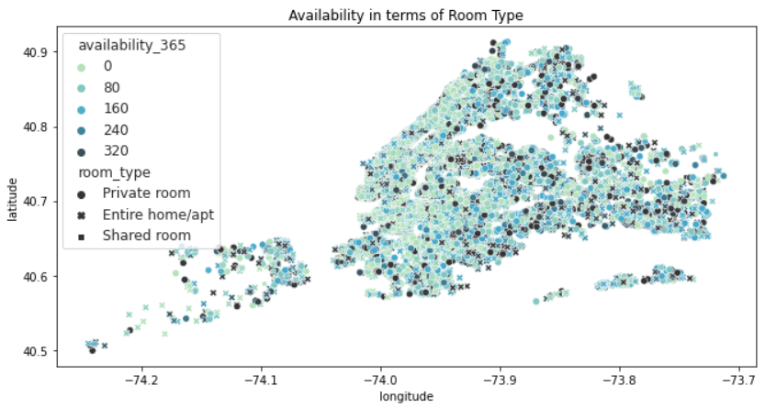
Occupancy rate over Properties
Manhattan & Brooklyn has a combined avg. availability of 106 days a year
The heart of NYC seems to be busiest
Availability based on Room types are spread quite uniformly

Slide 10
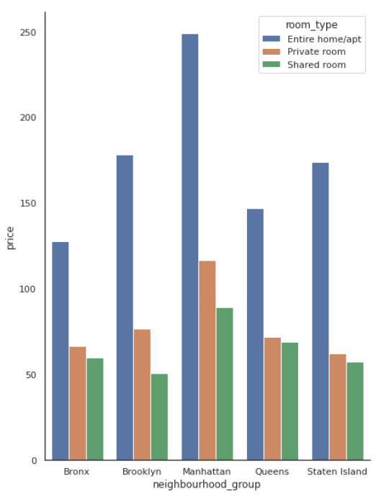
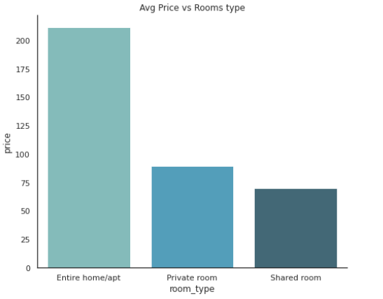
Distribution of Price over NY
“Entire home/apt” has avg. price of $211.79
“Private room” has avg. price of only $89.78
Shared rooms are the cheapest
Brooklyn and Manhattan stand within the most
urban and active area, in terms of listing count and pricing both.

Slide 11
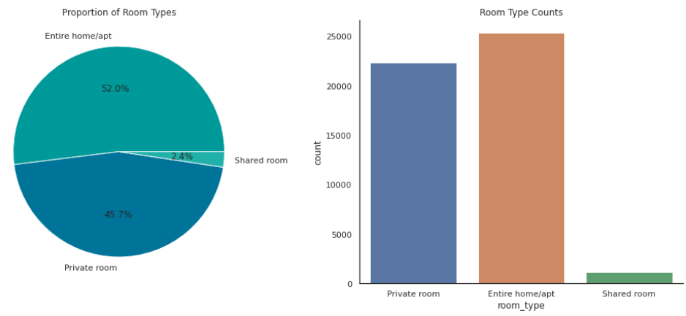
Proportion of Room types
“Entire room/apt” has more than 50% proportion with highest avg. property price
Despite being cheapest “shared room” shared only 2.4% proportion
Most of the listings available in NYC are entire home/apartment
No wonder NYC life is of high standard

Slide 12
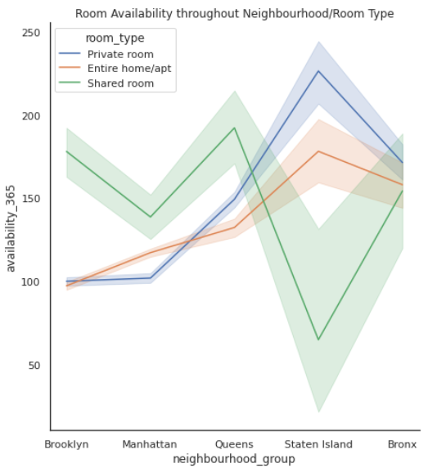
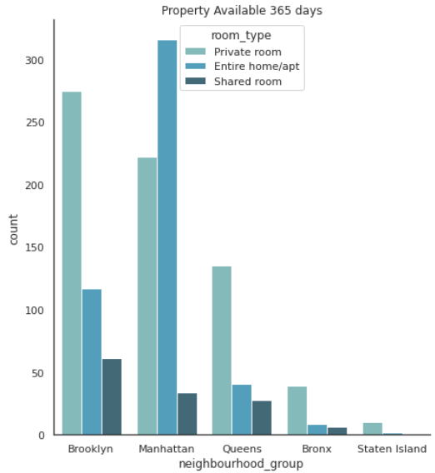
Property Occupancy Rate
There are 1295 total properties that are
available 365 days a year
Manhattan tops this
list with 572 properties while Brooklyn stands
at second with 453 properties available all year long
Location of the property and its lease value are not always guarantees of occupancy return

Slide 13
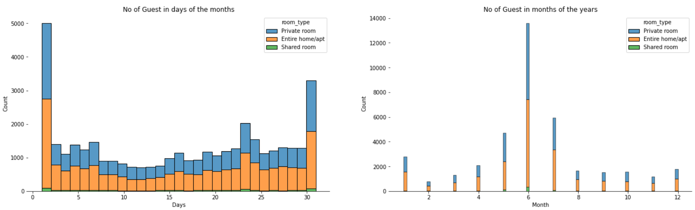
Occupancy Rate over entire season
Middle of the year, in June Month, there is a surge in guest count.
Greater movement in buildings at the end and beginning of the month
Between the months of the year, the vacation periods are also less busy.

Slide 14
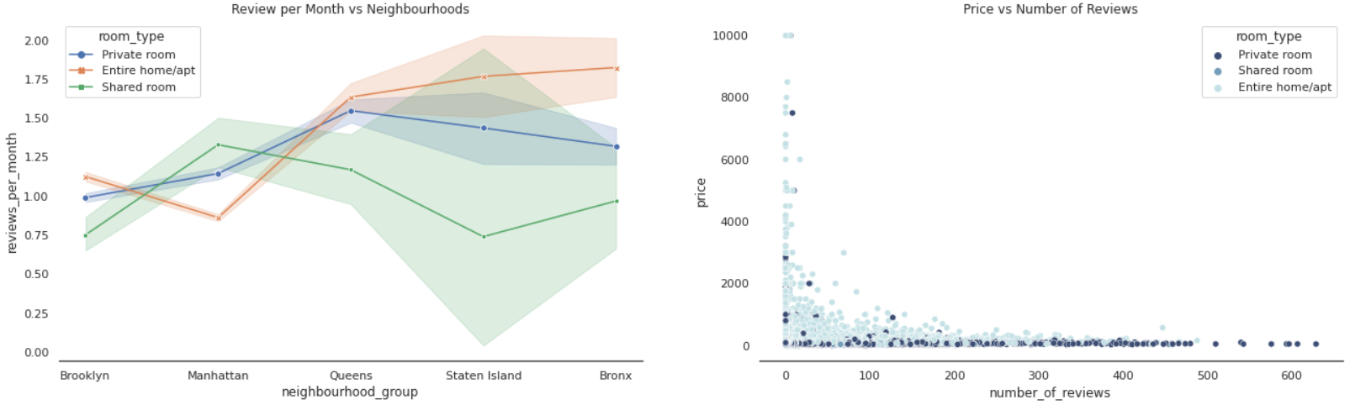
Distribution of visitors’ reviews
Staten Islands has highest number of average review count of 30.94 per property
Manhattan has lowest average review count per property of 20.98
Costlier properties has significantly less no. of reviews compared to cheaper properties
Cheaper rooms get more number of guest visits

Slide 15
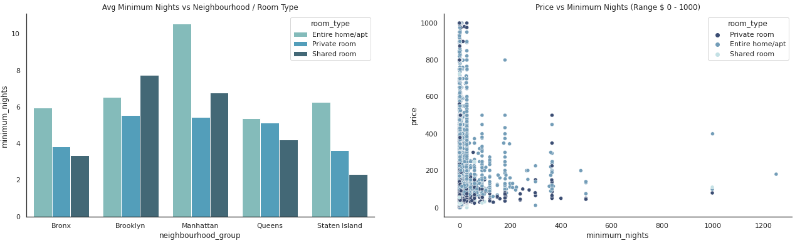
Distribution of mandatory stay
Within price range
$600 - 1000, avg. minimum stay is ~7 nights
Premium properties tends to allow low number of minimum nights
Most hosts allow less than 10 nights mandatory stay

Slide 16
Limitation
Dataset features in terms of modern world, are of very poor quality in deciding the valuation of a property
User ratings of hosts aren’t available, it would’ve been better to rank our hosts based on user
satisfaction and ratings. Normally a low rated property tends to lower their price
In order to have a better analysis regarding the quality of the properties, it would be interesting if we had an analysis of sentiments with property valuations.
The exact number of guests count also missing

Slide 17
Scope of Improvement
As dataset has few qualifying attributes to value a property, more features can be added like bedroom, bathroom, property age (it might be one of the most important one), applicable tax rate, distance to nearest airport, hospital or schools.
In presence of ratings, hosts can be classified and ranked, special discount or offer can be
given to highest rated hosts following marketing strategy
Time series analysis can be done to make prediction on occupancy rate based on tourist
season

Slide 18
Conclusion
Most visitors don’t prefer shared rooms, they tend to visit private room or entire home.
Manhattan and Brooklyn are the two distinguished, expensive & posh areas of NY
Some properties are having Minimum Nights to stay is more than 365 Days which can be favorable among Students, Low-Income Employees & Immigrants.
Though location of property has high relation on deciding its price, but a property in popular location doesn’t mean it will stay occupied in most of the time.

Slide 19

Thank You
As part of EDA Capstone Project by

